Slide 1


Year 2 | Week 4 | Day 1
Tens | Ones

Slide 2
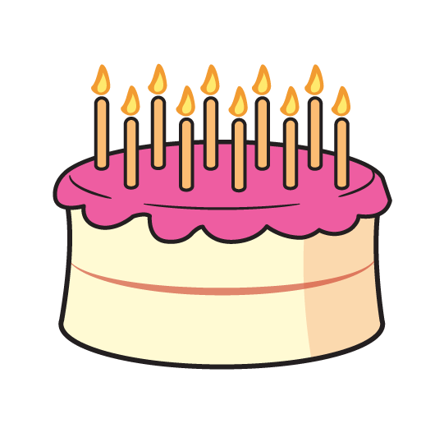
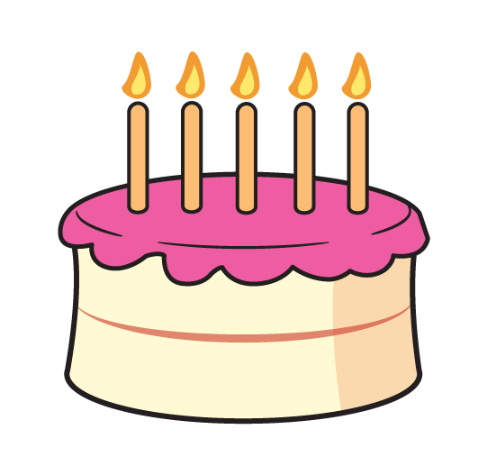
Year 2 | Week 4 | Day 2

Slide 3
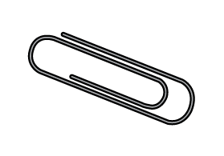

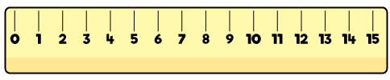
Year 2 | Week 4 | Day 3

Slide 4
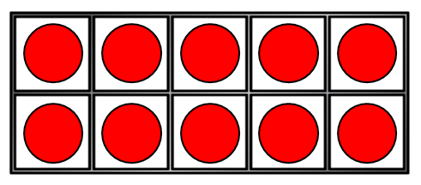
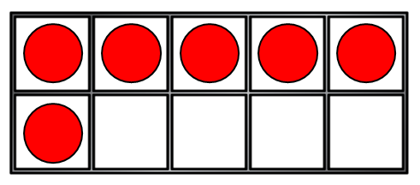
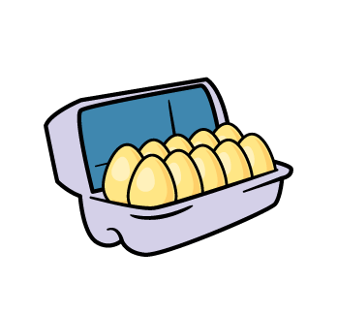
Year 2 | Week 4 | Day 4

Slide 5
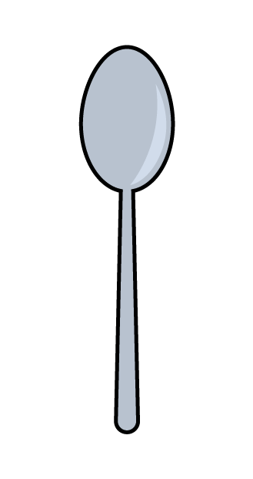


Year 2 | Week 4 | Day 5

Slide 6
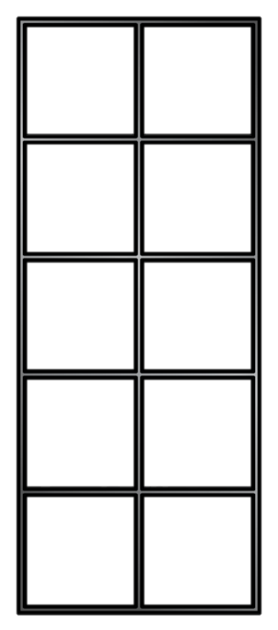
Year 2 | Week 5 | Day 1
14

Slide 7
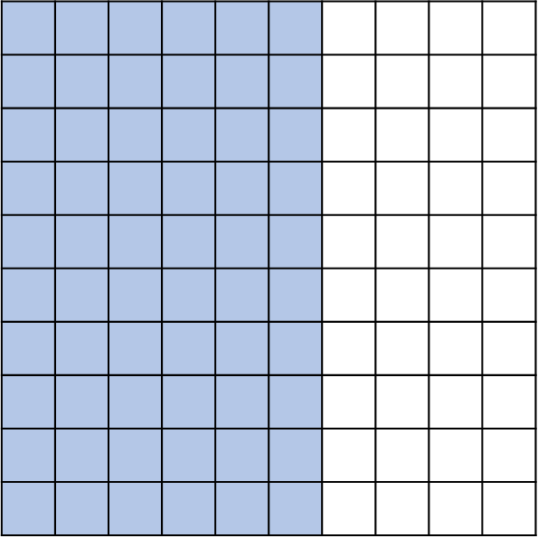
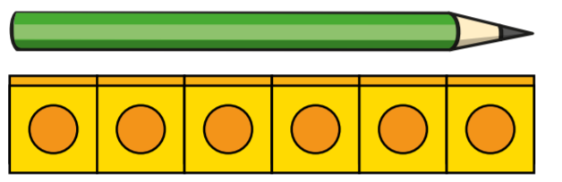
Year 2 | Week 5 | Day 2

Slide 8
Year 2 | Week 5 | Day 3
+

Slide 9
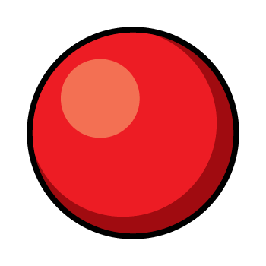
Year 2 | Week 5 | Day 4

Slide 10
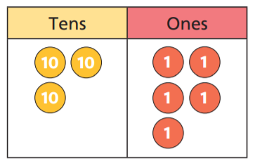
Year 2 | Week 5 | Day 5

Slide 11
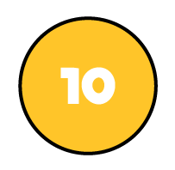

Year 2 | Week 6 | Day 1

Slide 12
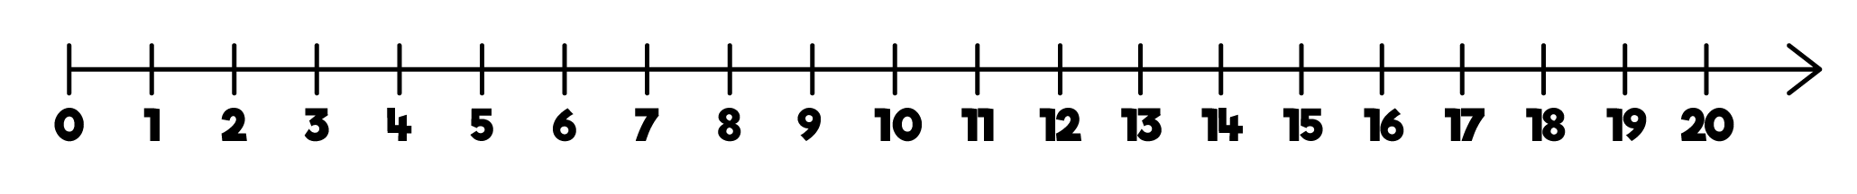
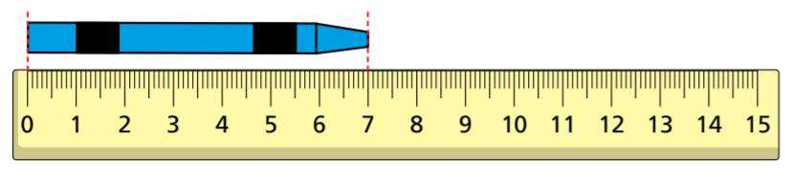
Year 2 | Week 6 | Day 2

Slide 13
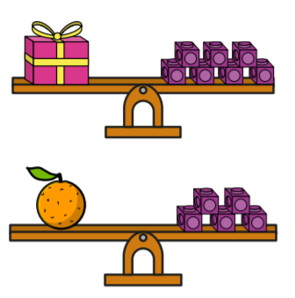
Year 2 | Week 6 | Day 3

Slide 14
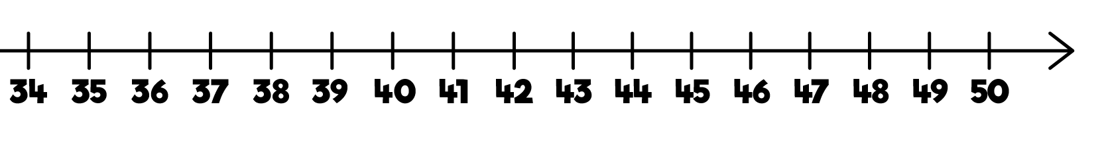
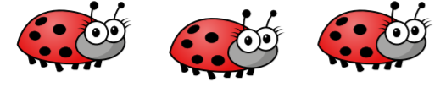
Year 2 | Week 6 | Day 4

Slide 15
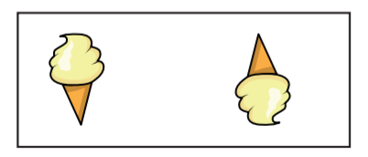
Year 2 | Week 6 | Day 5

Slide 16
Year 2 | Week 7 | Day 1

Slide 17
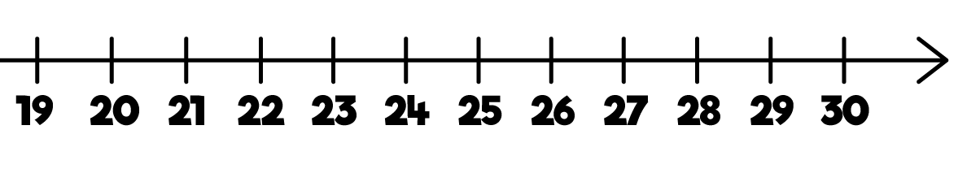
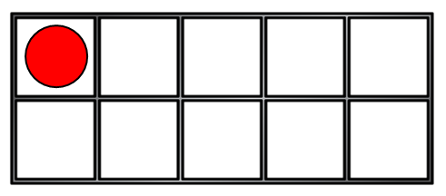
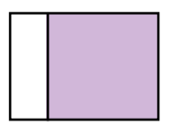
Year 2 | Week 7 | Day 2

Slide 18


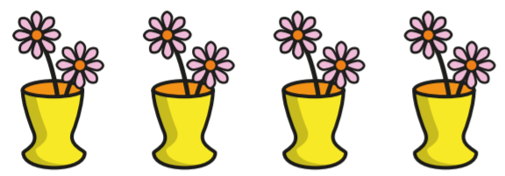
Year 2 | Week 7 | Day 3

Slide 19
Year 2 | Week 7 | Day 4

Slide 20
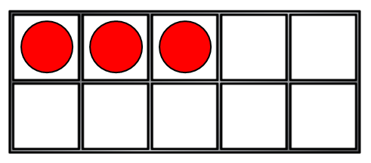
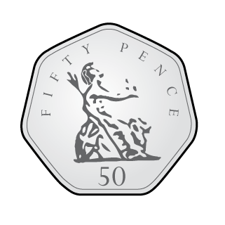
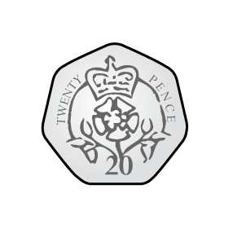
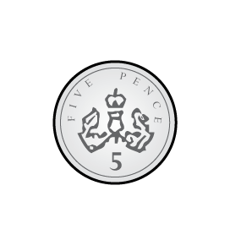
Year 2 | Week 7 | Day 5

Slide 21
Year 2 | Week 8 | Day 1

Slide 22
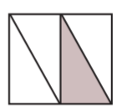
Year 2 | Week 8 | Day 2

Slide 23
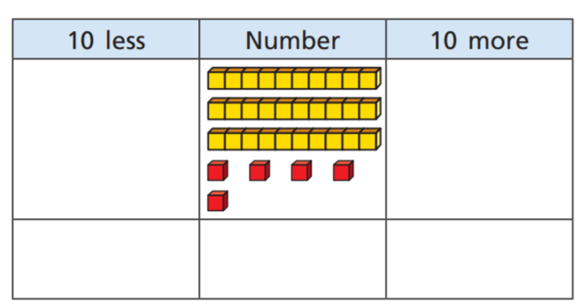
Year 2 | Week 8 | Day 3

Slide 24
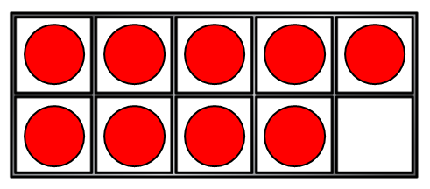
Year 2 | Week 8 | Day 4

Slide 25

Year 2 | Week 8 | Day 5

