Slide 1


Year 2 | Week 11 | Day 1
50p
5p

Slide 2
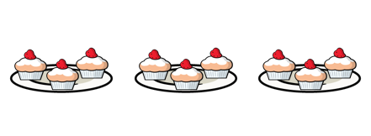
Year 2 | Week 11 | Day 2

Slide 3





Year 2 | Week 11 | Day 3

Slide 4


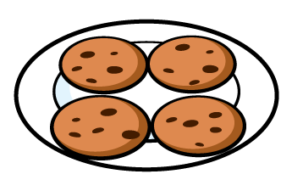
Year 2 | Week 11 | Day 4

Slide 5
Year 2 | Week 11 | Day 5

Slide 6



Year 2 | Week 12 | Day 1

Slide 7


Year 2 | Week 12 | Day 2

Slide 8


Year 2 | Week 12 | Day 3

Slide 9




Year 2 | Week 12 | Day 4

Slide 10



Year 2 | Week 12 | Day 5

